Slide 1


M.Tech/MCA Program
Advanced Industry Integrated Programs
Jointly offered by University and LTIMindTree
Review II
Real-Time AI-Driven Road Accident Detection and Emergency Alert System
Patel Vishrutkumar Dineshbhai
T-ID No: T8544
Knowledge partner | Implementation partner

Slide 2
Real-Time AI-Driven Road Accident Detection and Emergency Alert System
Introduction….
Problem Statement:
Road accidents cause thousands of fatalities and injuries each year.
Delayed reporting and response increase the severity of outcomes.
Manual monitoring of CCTV is inefficient and prone to human error.
Solution Approach:
AI-driven system to automatically detect accidents in real-time.
Uses CCTV feeds for vehicle detection, accident recognition, and severity assessment.
Generates instant alerts for dashboards and emergency responders.
Scalable for different cities, camera types, and environments.

Slide 3
Real-Time AI-Driven Road Accident Detection and Emergency Alert System
Objective….
Detect road accidents in real-time using AI and Deep Learning
Identify number of vehicles involved in the accident
Assess severity level of the incident
Send immediate alerts to monitoring dashboards & emergency teams
Reduce response time of ambulances and fire services

Slide 4
Real-Time AI-Driven Road Accident Detection and Emergency Alert System
Module Progress
Module 1 & 2: Data Processing (Complete)
Processed 613 raw videos using YOLOv8 + ByteTrack.
Generated frame-by-frame tracking data with consistent object IDs.
Manually labeled a ground truth dataset with precise accident event windows (start and end frames) and severity.
Module 3 & 4: Model Training & Severity Logic (Complete)
Prepared a multimodal dataset combining video clips with their corresponding physical features (velocity, overlap, etc.).
Successfully trained a Multimodal Fusion Model to detect crash events.
Developed a "Smart Filter" to precisely count involved vehicles based on chaotic motion.

Slide 5
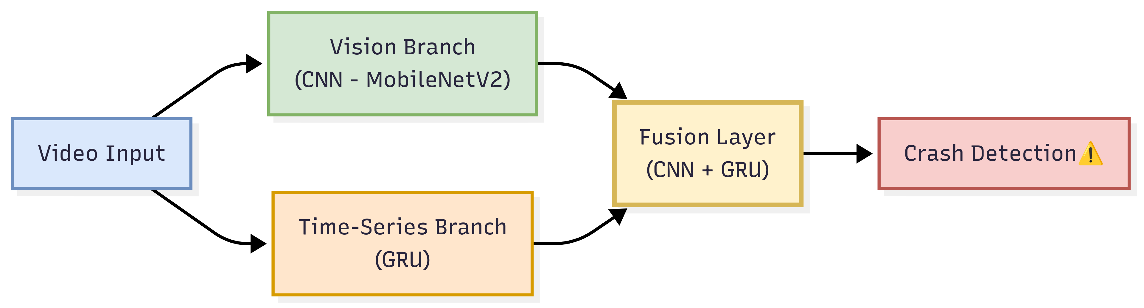
Real-Time AI-Driven Road Accident Detection and Emergency Alert System
Methodology/Modeling Plan….
Multimodal Fusion Approach → combines visual + motion features
Vision Branch (CNN – MobileNetV2) → learns crash visuals (collision, smoke, damage)
Time-Series Branch (GRU) → captures crash dynamics (sudden speed drop, overlap)
Fusion Layer → merges spatial + temporal insights for final decision
Outcome → robust, accurate detection under varied traffic & conditions

Slide 6
Real-Time AI-Driven Road Accident Detection and Emergency Alert System
Data preprocessing & EDA….
Automated Processing
YOLOv8 → object detection.
ByteTrack → tracking IDs.
Features: velocity, deceleration, IoU.
Manual Ground Truth
Accident event windows (start/end).
Assigned severity labels (Low/Med/High).
Final Dataset
Visual Clips: 32 frames.
Feature Data: velocity, IoU, deceleration.

Slide 7
Real-Time AI-Driven Road Accident Detection and Emergency Alert System
Approach/Algorithms/Tools….
Approach
Real-time CCTV monitoring with sliding window detection
Multimodal analysis (visual + motion features)
Algorithms
YOLOv8 – Object Detection
ByteTrack – Object Tracking
CNN (MobileNetV2) – Visual Features
GRU – Temporal Dynamics
Fusion Classifier – Crash Decision
Tools
Python, PyTorch
OpenCV, Matplotlib
Custom annotation scripts

Slide 8
Real-Time AI-Driven Road Accident Detection and Emergency Alert System
Project plan/milestones progress
Completed Milestones:
✅ End-to-end data processing pipeline established.
✅ Manual ground truth dataset created.
✅ State-of-the-art Multimodal Fusion Model successfully trained.
✅ Real-time Smart Filter for identifying involved vehicles implemented.
✅ Proof-of-concept Live Analyzer script developed.
Next Steps:
Model Optimization: Experiment with fine-tuning the trained model and different hyperparameters to further improve accuracy.
API Integration: Develop a robust API endpoint to send the structured alert data to an external dashboard or emergency service system.
Scalability Testing: Test the pipeline's performance on multiple simultaneous video streams to ensure real-world viability.

Slide 9
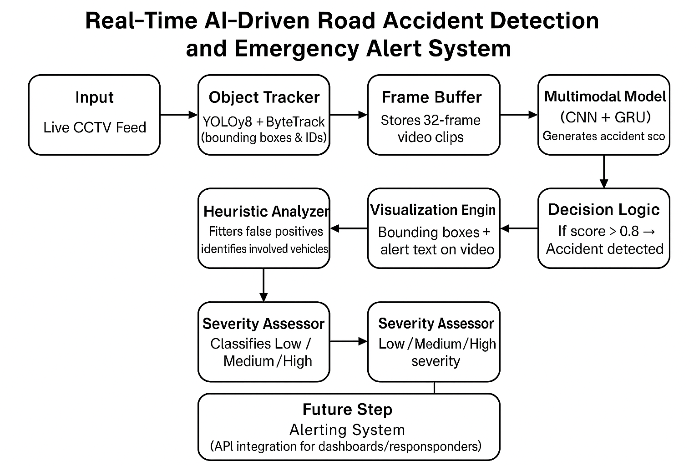
Real-Time AI-Driven Road Accident Detection and Emergency Alert System
Pipeline structure

Slide 10
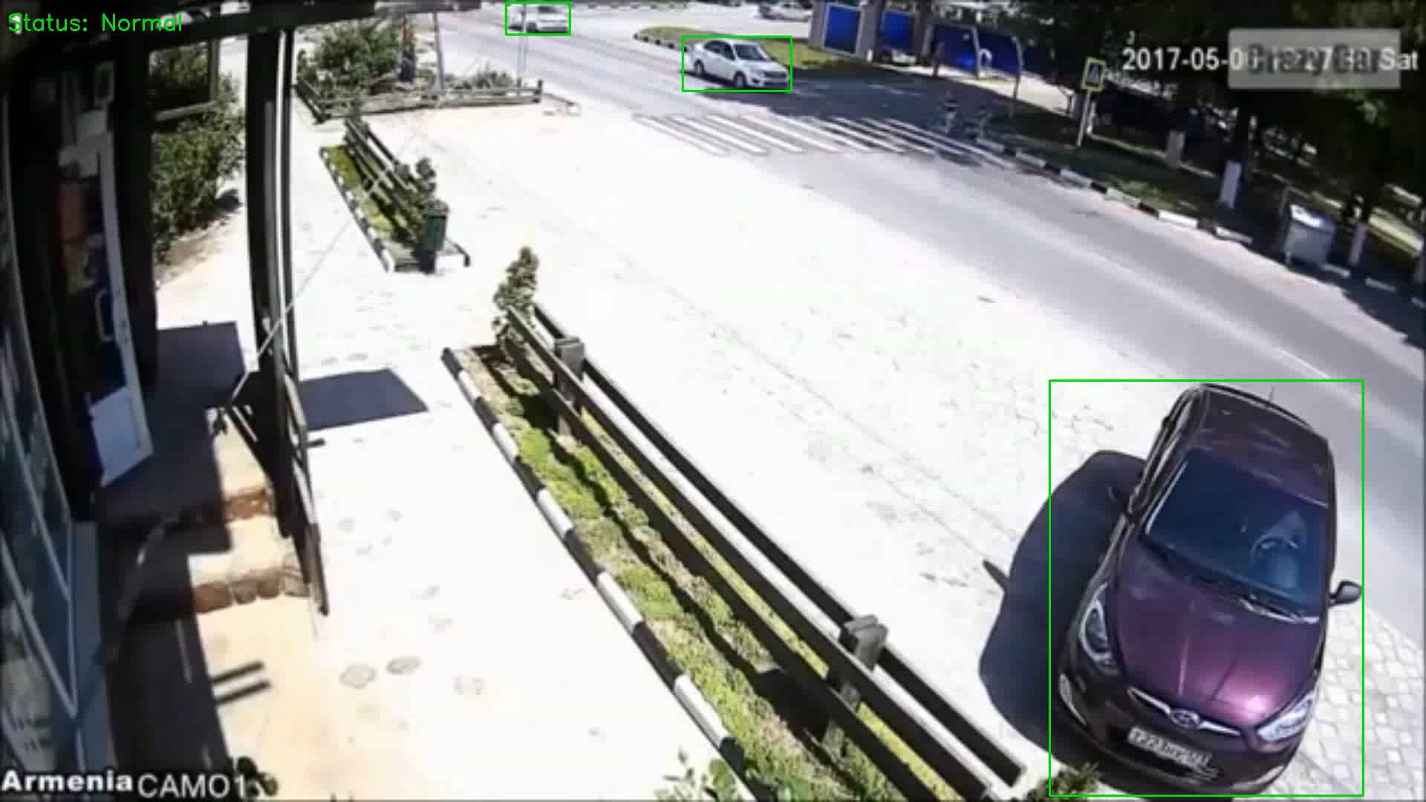
Real-Time AI-Driven Road Accident Detection and Emergency Alert System
Accident Detection Output – Demo Clip

Slide 11
Real-Time AI-Driven Road Accident Detection and Emergency Alert System
Thank You!

